Slide 1
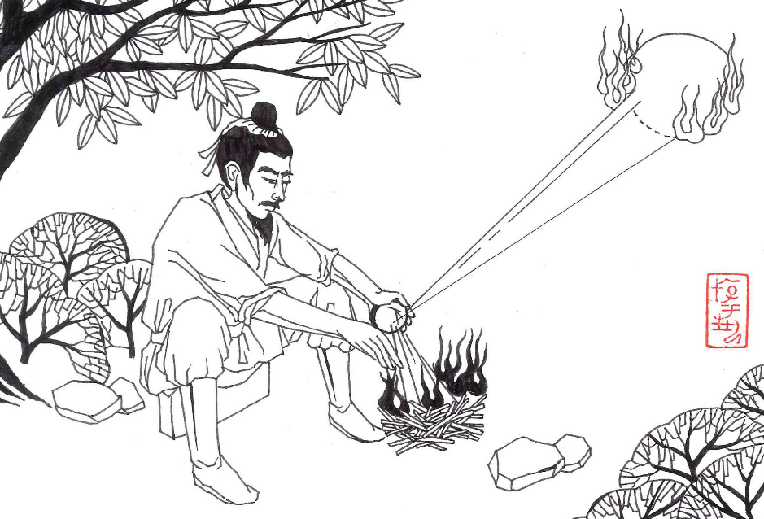
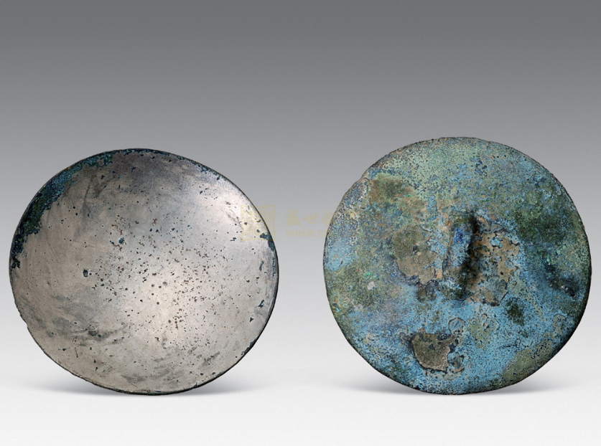
Ancient solar techlonogies
Sundial, Yangsui and magic mirror
Burning Mirrors (or Sun flint, in Chinese: Yangsui)
Since the beginning of the Zhou Dynasty (1056 B.C. – 256 B.C.) , there are many books describing the function of Yangsui, and that appeared from the Chinese Bronze Age. Concave mirrors made of bronze could concentrate the sunlight onto an object to make it burst into flames within seconds. Yangsui: the oldest solar device in the human history !*
Illustration drawn by Ms. Zhou Rongrong
Diameter：51 mm, concave mirrors, Qin Dynasty (221 B.C.-206 B.C)
* John Perlin: LET IT SHINE, P37-55, New World Library, Novato, California

Slide 2
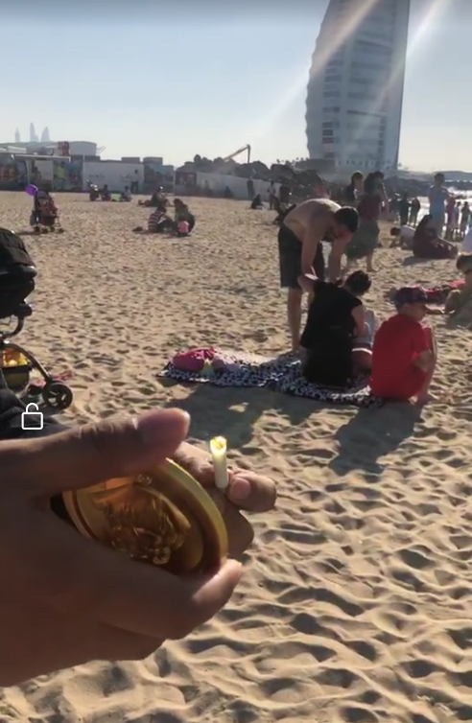
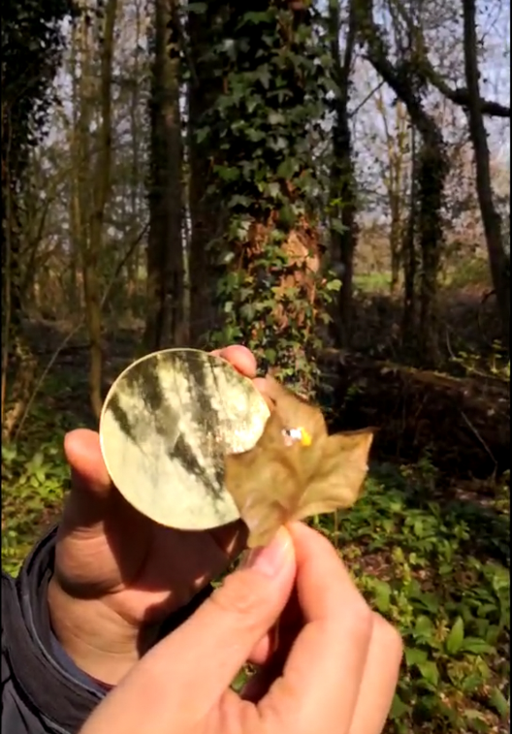
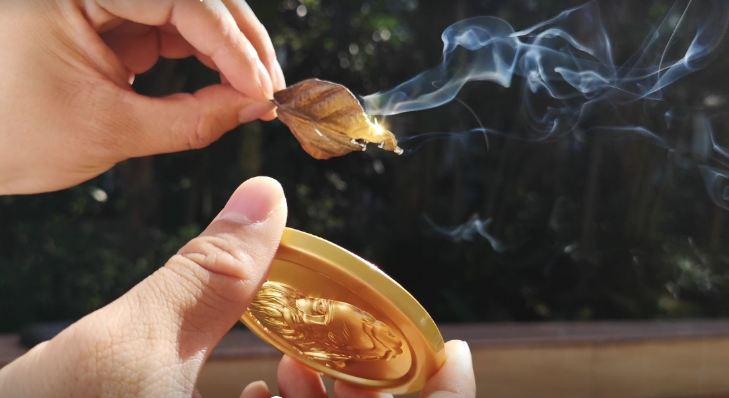
Ancient solar techlonogies
Sundial, Yangsui and magic mirror
Experiments using a concave mirror to collect sunlight to obtain fire
Dubai
Jülich
Guangzhou
Fire - generating experiments using a concave mirror (Yangshui): in Guangzhou, Foshan, Xuzhou, Chengdu, Xining (minus 20 degrees), In China, in Karachi, Pakistan, in Dubai, United Arab Emirates, in Jülich, Germany. Yangsui can be stamped and formed from a metal alloy with a spherical or parabolic polished surface.

Slide 3
Ancient solar techlonogies
Sundial, Yangsui and magic mirror
Functions of ancient bronze mirrors
Ancient bronze mirrors have many functions: - The first, it’s used as a normal mirror for viewing personal image and makeup； - Second, used to ward off evil spirits; - Third, it called as Yangsui (the concave reflection bronze mirror), which can be used to get fire from the sun.
- Forth, it called the light transmitting mirror or magic mirror, its function will be explained later.

