Slide 1
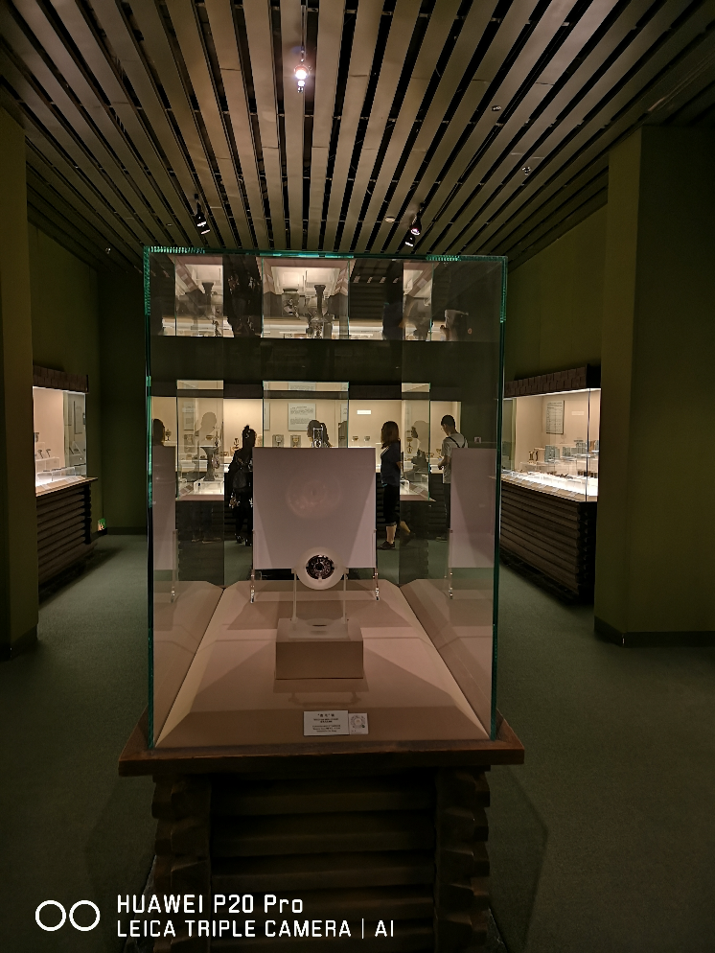
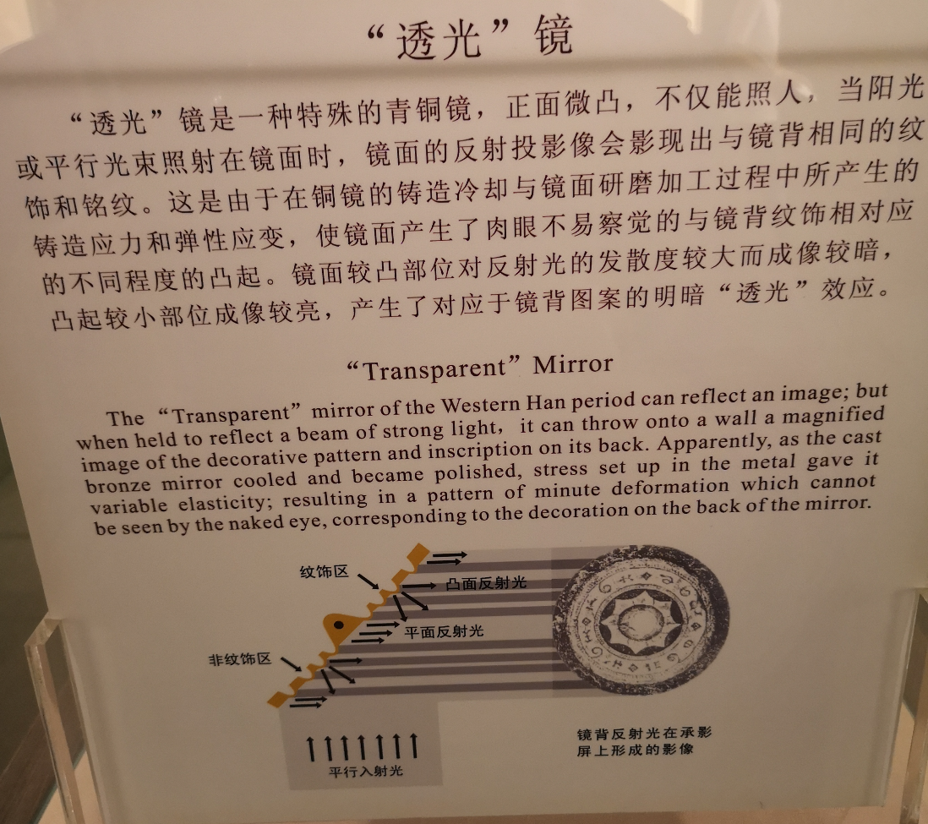
Ancient solar techlonogies
Sundial, Yangsui and magic mirror
Transparent mirrors (The original - in Shanghai Museum) The Western-Han Dynasty (206 B.C. - A.D. 24)
Photo: Hui Shen

Slide 2
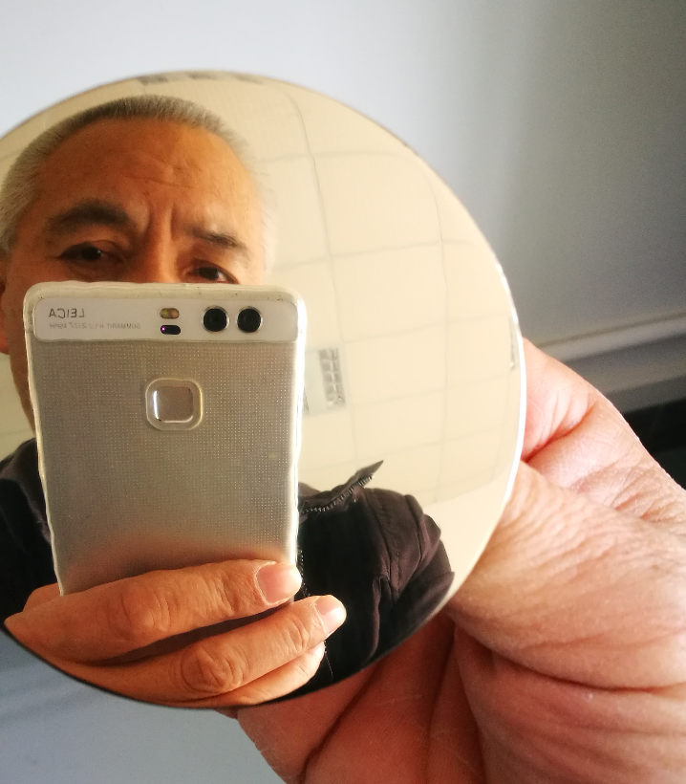
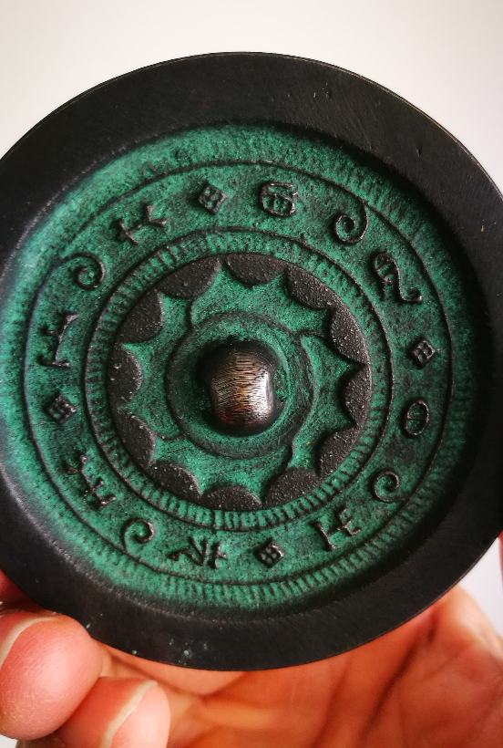
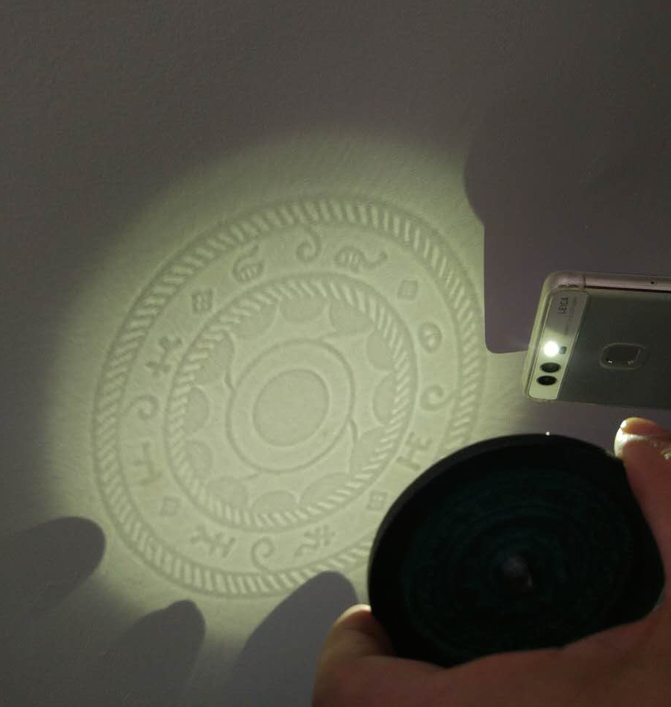
Ancient solar techlonogies
Sundial, Yangsui and magic mirror
Transparent mirrors
The Western Han Dynasty (206 B.C. - A.D. 24)
Front site
Back site
If sunlight enters the front of mirror, it will reflect an image the same as the back of the mirror

Slide 3
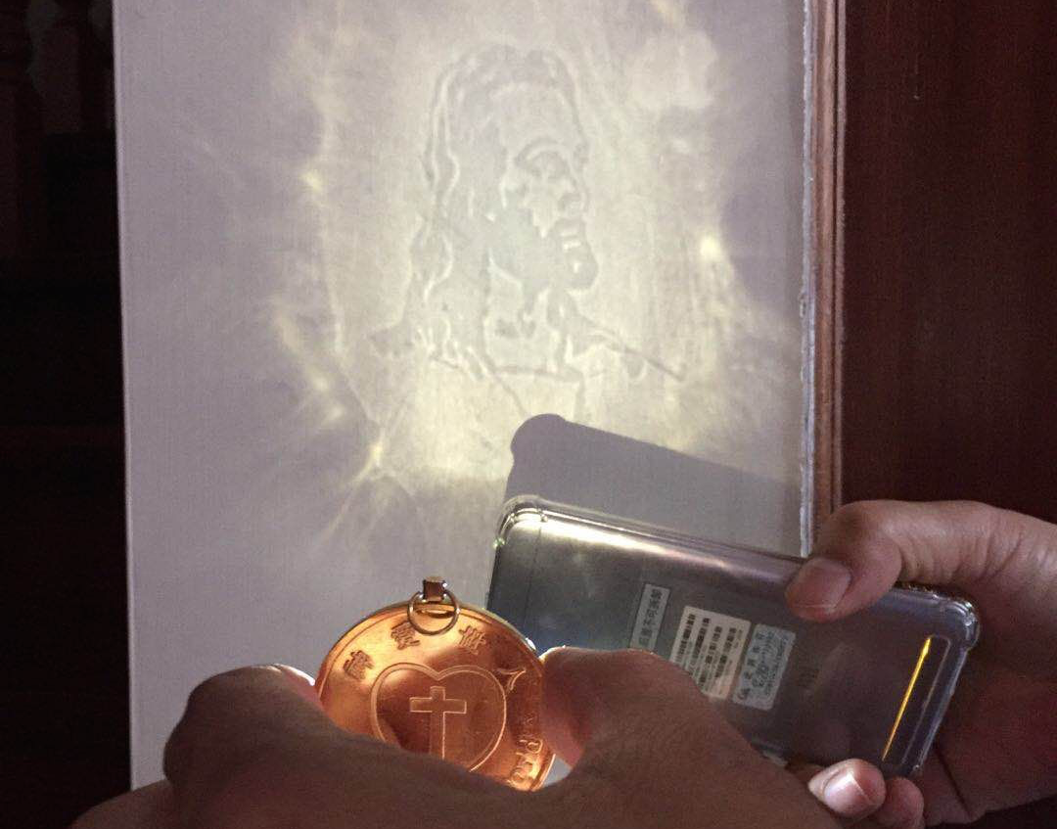
Ancient solar techlonogies
Sundial, Yangsui and magic mirror
Reflected image can be different from the pattern on the back (here Jesus), I do not know whether the color image can be made later ?

Slide 4
Ancient solar techlonogies
Sundial, Yangsui and magic mirror
A. Einstein: Photon (Lichtquant) concept Photoelectric effect equation : hv = ½ mv² + A
This bronze mirror can show an image, if a beam of strong light (better using sunlight) is incident to the mirror. And the image can be the same like the pattern on the back side of the mirror. The mirror was casted, then cooled, polished, and stress set up in the bronze gave it variable elasticity. Finally, resulting in a pattern of tiny deformation which can not be seen by the naked eye, corresponding to the pattern on the back of the mirror.
Fantasy ist wichtiger als Wissen!
Imagination is more important than knowledge!

Slide 5
Ancient solar techlonogies
Sundial, Yangsui and magic mirror
Functions of ancient bronze mirrors
Ancient bronze mirrors have many functions: - The first, it’s used as a normal mirror for viewing personal image and makeup； - Second, used to ward off evil spirits; - Third, it called as Yangsui (the concave reflection bronze mirror), which can be used to get fire from the sun.
- Forth, it called the light transmitting mirror or magic mirror, its function will be explained later.

